Slide 1


LECTURE 2B:
CENSORSHIP AND RATINGS
Co1035:
Game
CONCEPTS

Slide 2
Objectives
Understand the concept of censorship and rating systems in video games
Explore how different countries apply regulations
Identify the main global rating systems
Examine real-world examples of censorship and classification
Evaluate the impact of these systems on players, developers, and society

Slide 3
Introduction
Video games are a global form of Entertainment and an Art Medium.
Hence, they need a form of Regulation.
Regulation occurs via:
  Censorship: modifying or restricting content.
  Rating Systems: providing age-appropriate classification.
Both are meant to balance freedom of expression with the protection of the audience.

Slide 4
What is Censorship in Games?
Limitation or modification of content by:
  Governments (through laws and bans)
  Publishers/Platforms (self-censorship)
  Culture of Political Institutions
Commonly censored elements:
  Extreme violence
  Sexual or nudity content
  Political/ideological references
  Religious symbolism
  Drugs or gambling themes

Slide 5
Some Examples of
Censorship Worldwide
Germany (EU)
  Strict restrictions on Nazi symbols until 2018
    (e.g.) Wolfenstein edited to remove swastikas
United Kingdom
  Some games refused classification
    (e.g.) Manhunt 2 was initially banned in 2007 for violence
China
  Bans politically sensitive or supernatural content
    (e.g.) PUBG – rebranded as a Game of Peace
Australia
  Games like Fallout 3 were censored due to drug use themes

Slide 6
But why does censorship happen? (Purpose)
Protect vulnerable groups (esp. minors) from harmful content
Help parents/guardians make informed decisions.
Comply with national laws (maintain legal compliance)
Maintain cultural and moral standards
Control political narratives
Ensure games can be legally sold in different markets
Balance: Creative freedom and social responsibility

Slide 7
So, what are rating systems?
Age-based classification tools for parents, players, and retailers
Provide guidance (but not always legal restrictions)
Use age categories and content descriptors
Vary by region but share the same goal
  To help the customers make informed choices

Slide 8
Major Rating
Systems (Global)
PEGI (EU and UK)
  Ratings: 3, 7, 12, 16, 18
ESRB (North America)
  Ratings: eC (early childhood), E (everyone), E+10 (everyone 10+), T (teen [13+]), M (mature [17+]), AO (adults only [18+])
CERO (JAPAN)
  Ratings: A (all), B (12+), C (15+), D (17+), Z (18+)
Other Systems
  USK (Germany)
  ACB (Australia)
  IARC (Digital global systems)

Slide 9
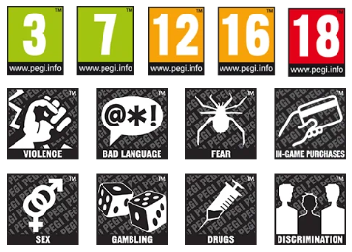
PEGI Ratings System
Pan European Game Information (PEGI)
The system was established in 2003
Adopted by most EU countries + UK
Age categories: 3, 7, 12, 16, 18
Includes content descriptors
The UK is a participant in the PEGI system.
Cyprus officially supports PEGI, but there is no specific legislative basis
  No age or content rating system in place and no related legislation.

Slide 10
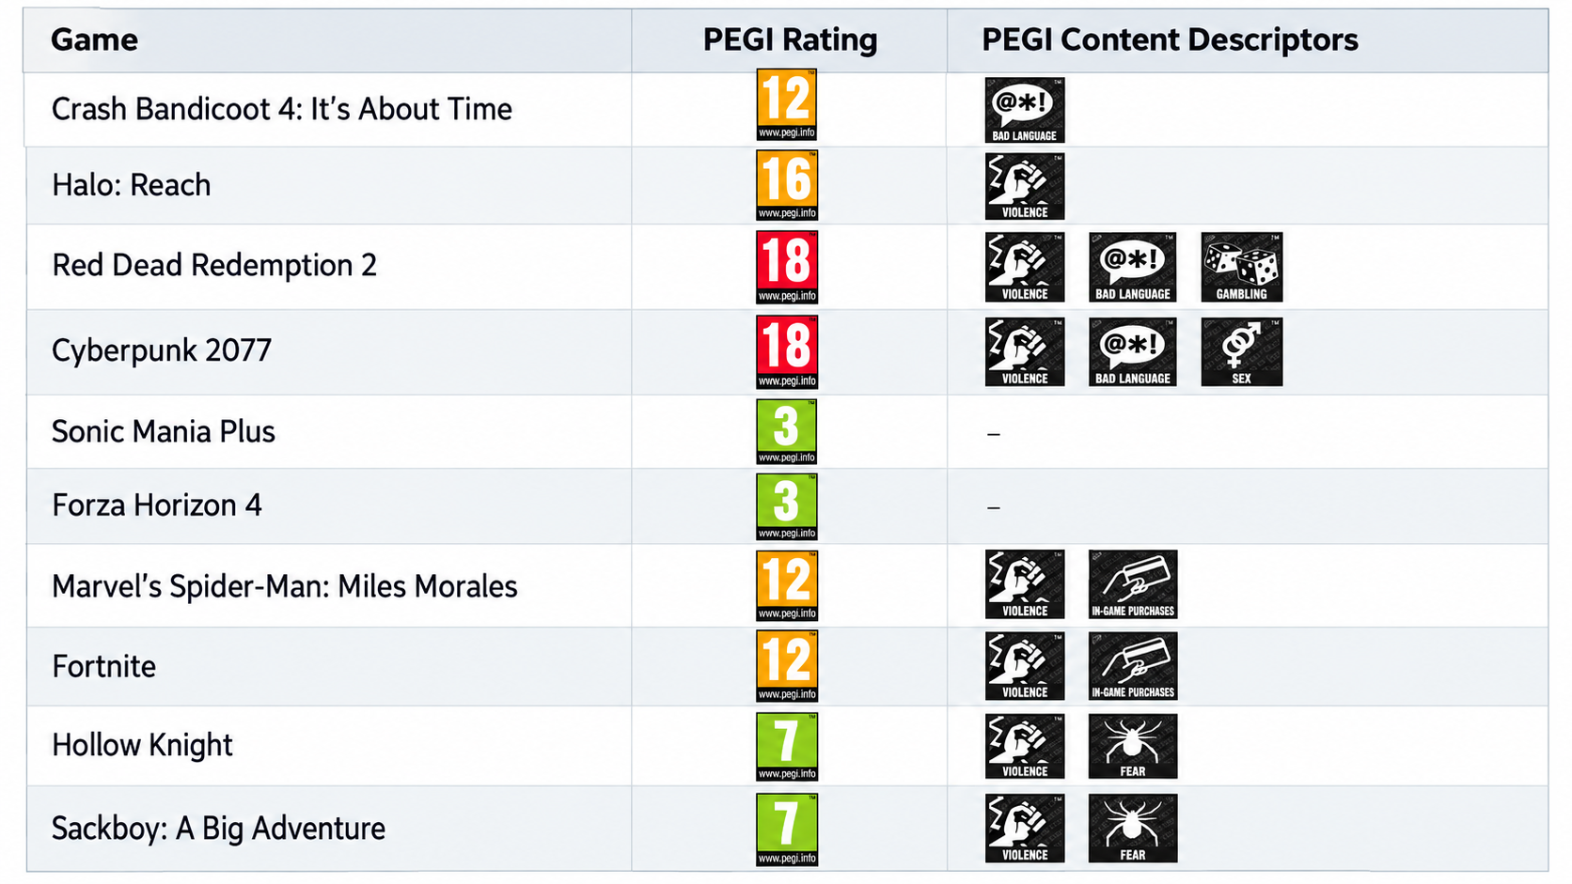
Examples of PEGI Ratings

Slide 11
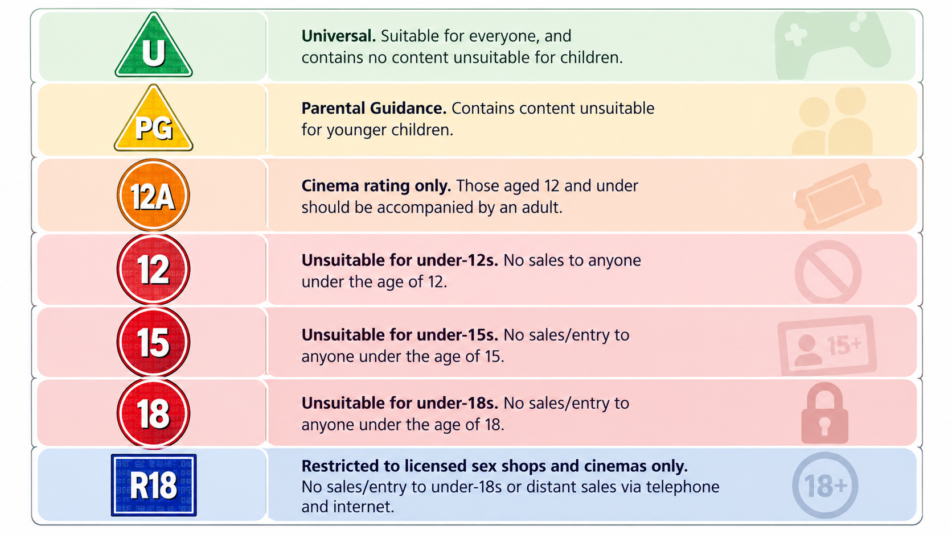
BBFC (UK)
British Board of Film Classification (BBFC)
The system was established in 1912,
Originally for films, but historically responsible for classifying video games in the UK before 2012
Focused on: violence, sex, language, horror, drugs
The system was abandoned in 2012 for games and replaced with PEGI

Slide 12
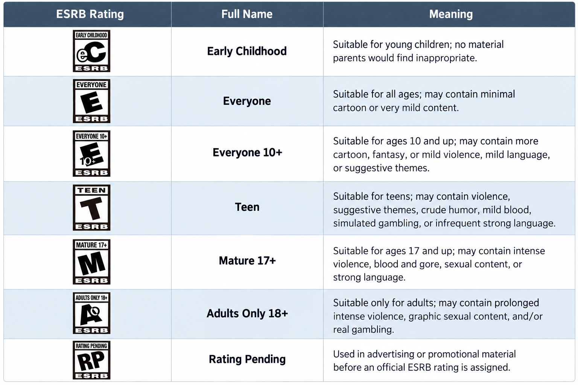
ESRB Rating
System
Entertainment Software Rating Board (ESRB)
Founded in 1994 by the Entertainment Software Association (ESA)
Mainly used in the USA, Canada, and Mexico
Different kinds of censorship in the UK and the rest of Europe.

Slide 13
ESRB Content Descriptors
Alcohol Reference
Animated Blood
Blood
Blood and Gore
Cartoon Violence
Comic Mischief
Crude Humor
Drug Reference
Fantasy Violence
Intense Violence
Language
Alcohol Reference
Lyrics
Mature Humor
Nudity
Partial Nudity
Real Gambling
Sexual Content
Sexual Themes
Sexual Violence
Simulated Gambling
Strong Language
Strong Lyrics
Strong Sexual Content
Suggestive Themes
Tobacco Reference
Use of Drugs
Use of Alcohol
Use of Tobacco
Violence
Violent Reference

Slide 14
How Ratings Work
Publishers submit game footage and a questionnaire
Review panels analyze:
  Violence intensity and realism
  Language used (mild to strong)
  Sexual content and nudity
  Drugs, alcohol, and gambling
  Frightening or horror elements
Outcome: age label and descriptors

Slide 15
Inconsistencies and Other Issues
Sims 4 was Rated as “T” by ESRB, 12 by PEGI, 6+ by USK, and 18+ by RARS.
Mass Effect was rated 12 by BBFC and 18 by PEGI due to a controversial side mission, including a sex scene.
Sexy Poker was rated 15 by the BBFC and 12 by PEGI, even though it uses nudity as an incentive/reward.
Manhunt 2 refused a rating by the BBFC, but ESRB rated the game as AO (Adults Only).

Slide 16
Criticism and Challenges
Censorship issues:
  Limits artistic expression
  Inconsistent across countries
Rating Issues:
  Not always enforced (especially in digital platforms)
  Different standards in different regions
  Online games usually bypass age checks
Examples: same games may be PEGI 18 in the EU, but M(17+) is US

Slide 17
Conclusion
Censorship and ratings deeply affect game development and distribution
EU & UK use PEGI while other regions use other systems.
Censorship varies - what’s banned in one country may be fine in another.
Core tension: player protection vs freedom of expression
Future: Unknown due to global harmonization (including online gambling and AI-generated content)

Slide 18
Questions?!

